Slide 1
Genomic Tag Placement
Kent A. Vander Velden
Notes:
We will begin with a short review of DNA sequence data before introducing the problem of tag placement and why CPUs are not well suited to this problem.
We will then present our design, performance comparison to a CPU, and conclude with some potential improvements.

Slide 2
ctgcatgtacaagcgcgttagctagatagctgtatcgtacgtagctagtcgtatc
Notes:
DNA is recoded using the four characters A, G, C, and T into long strings

Slide 3
5’–ctgcatgtacaagcgcgttagctagatagctgtatcgtacgtagctagtcgtatc—3’
Notes:
The strings have polarity and thus direction.
They are arranged from the start, designated 5’, to the end, designated 3’.

Slide 4
5’–ctgcatgtacaagcgcgttagctagatagctgtatcgtacgtagctagtcgtatc—3’
a <-> t
c <-> g
Notes:
These characters have a symmetric pairing relationship such that A pairs with T and C pairs with G

Slide 5
5’–ctgcatgtacaagcgcgttagctagatagctgtatcgtacgtagctagtcgtatc—3’
3’–gacgtacatgttcgcgcaatcgatcgatagacatagcatgcatagatcagcatag—5’
a <-> t
c <-> g
Notes:
The symmetric pairing results in each string having a complementary string…

Slide 6
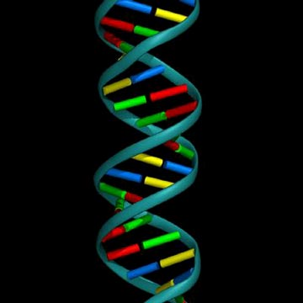
5’–ctgcatgtacaagcgcgttagctagatagctgtatcgtacgtagctagtcgtatc—3’
3’–gacgtacatgttcgcgcaatcgatcgatagacatagcatgcatagatcagcatag—5’
a <-> t
c <-> g
DNA double helix.
Suhail Islam, Imperial Cancer Research Fund, London
Notes:
… ultimately forming the familiar double helix…

Slide 7
ctgcatgtacaagcgcgttagctagatagctgtatcgtacgtagctagtcgtatc
tgcc
cgaa
caat
taga
tatc
acga
Notes:
The problem we addressed is, given a reference sequence and a set of tags, find the position of each of these tags.
This is an important step in gene identification and mapping.

Slide 8
ctgcatgtacaagcgcgttagctagatagctgtatcgtacgtagctagtcgtatc
tgcc
cgaa
caat
taga – 23 fwd
tatc – 34 fwd
acga
Notes:
We compare each tag against each position of the genome recording the position when there is a match.

Slide 9
5’–ctgcatgtacaagcgcgttagctagatagctgtatcgtacgtagctagtcgtatc—3’
tgcc
cgaa – 11 rev
caat
taga – 23 fwd
tatc – 34 fwd
acga
Notes:
But also must check the reverse direction in case our tag or sequence is backwards.

Slide 10
5’–ctgcatgtacaagcgcgttagctagatagctgtatcgtacgtagctagtcgtatc—3’
3’–gacgtacatgttcgcgcaatcgatcgatagacatagcatgcatagatcagcatag—5’
tgcc
cgaa – 11 rev
caat – 17 comp
taga – 23 fwd
tatc – 34 fwd
acga
Notes:
We must also check the complementary strand in the forward direction…

Slide 11
5’–ctgcatgtacaagcgcgttagctagatagctgtatcgtacgtagctagtcgtatc—3’
3’–gacgtacatgttcgcgcaatcgatcgatagacatagcatgcatagatcagcatag—5’
tgcc
cgaa – 11 rev
caat – 17 comp
taga – 23 fwd
tatc – 34 fwd
acga – 50 rev comp
Notes:
… and in the reverse direction.

Slide 12
5’–ctgcatgtacaagcgcgttagctagatagctgtatcgtacgtagctagtcgtatc—3’
3’–gacgtacatgttcgcgcaatcgatcgatagacatagcatgcatagatcagcatag—5’
tgcc – 2 rev comp, 1 mismatch
cgaa – 11 rev
caat – 17 comp
taga – 23 fwd
tatc – 34 fwd
acga – 50 rev comp
Notes:
To allow for potential sequencing error and evolutionary drift, we need to allow for some amount of mismatch.

Slide 13
CPU Method
for i = 1 to genome.length
if ...
record match at position i
end if
end
Notes:
To perform this analysis with a CPU we construct a program that iterates over the genome, recoding position of a tag if some criteria is met.

Slide 14
CPU Method
for i = 1 to genome.length
for j = 1 to tags.count
if ...
record match at position i
end if
end
end
Notes:
For each genome position, we must test each tag.

Slide 15
CPU Method
for i = 1 to genome.length
for j = 1 to tags.count
for k = 1 to tags[j].length
end
if ...
record match at position i
end if
end
end
Notes:
For each tag, we must loop over the length of the tag…

Slide 16
CPU Method
for i = 1 to genome.length
for j = 1 to tags.count
for k = 1 to tags[j].length
if genome[i] != tags[j][k]
end if
end
if ...
record match at position i
end if
end
end
Notes:
… comparing the tag against the genome.

Slide 17
CPU Method
for i = 1 to genome.length
for j = 1 to tags.count
hd = 0
for k = 1 to tags[j].length
if genome[i] != tags[j][k]
hd = hd + 1
end if
end
if hd <= max_hd
record match at position i
end if
end
end
Notes:
We do this to measure the Hamming distance between each tag and each position on the genome recording a match if the Hamming distance is less than or equal to a predetermined maximum.
This method only completes one forth of the number of required tests, since it only checks the forward direction. Three more tests are necessary within the inner most for-loop.

Slide 18
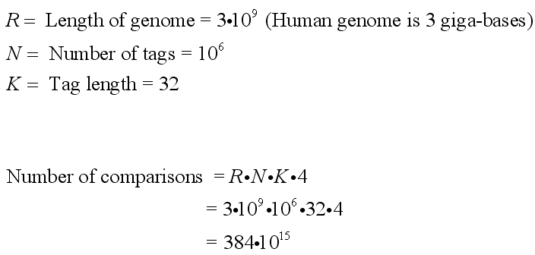
Notes:
The problem appears easy until presented with the vastness.
The human genome is 3 giga-bases and it is now possible to produce a million tags daily each 32 bases long.
This results in 384 quadrillion or 384 thousand billion comparisons to perform.

Slide 19
FPGA Method (top level)
Notes:
This is the highest level representation of our design.

Slide 20
FPGA Method (top level)
MP1
Notes:
We used the Ethernet layer module from MP1 for communication starting from the link layer interface.

Slide 21
FPGA Method (top level)
MP1
Tag comparison
Notes:
… then adding a second DCM generating a 25MHz clock and a driver module for our design.
The bulk of our design exists in the driver module.

Slide 22
FPGA Method (driver)
Notes:
The driver module consists of incoming and outgoing FIFOs and respective controlling FSMs.
The driver module abstracts the I/O from the main cmp_driver module. The Ethernet header is discarded on as new frames are read, and a UDP header is added as outgoing frames are constructed.
The driver module also helps by shuffling data between clock domains.
These features make it a nice module to help those who wish to use an Ethernet interface and can’t process the bytes at the rate they are received.

Slide 23
FPGA Method (driver)
Notes:
At this point, we encounter the first level of parallelism.
The incoming and outgoing FSMs and FIFO are able to work in parallel with each other.
We can exploit this by, on the transmitting side, staying one data frame ahead of what has been received.

Slide 24
FPGA Method (cmp driver)
Notes:
The cmp_driver contains a FSM to drive the each of the 96 comparison units. The FSM is responsible for loading the compare units with tags from the first frame, the configuration frame, and for driving each of the control lines to read from and write to the FIFOs.

Slide 25
FPGA Method (cmp driver)
Notes:
Course parallelism is expressed with the replication of comparison units. This replaces one of the for-loops we had in our CPU version.
Also, the final results are reduced, in parallel, to two bits from all the comparison units.

Slide 26
FPGA Method (replication of cmp_unit)
gen_cmp_units: for n in 1 to cmp_unit_count generate
cmp_unit : compare_unit
generic map (
id => n -- input
)
port map (
clk => cmp_clk, -- input
reset => reset_i, -- input
load_tag => kmer_load, -- input
load_mhd => mhd_load, -- input
kmer => kmer, -- input
index => cu_index, -- input
check_rc => check_rc, -- input
check_fwd => check_fwd, -- input
check_rev => check_rev, -- input
result => raw_result(n-1) -- output
);
end generate;
Notes:
Here is a more detailed view of the replication of the comparison units…
Much of the parallelism in our design is expressed using parameterized for-generate constructs.
This construct replicates a section of concurrent VHDL code, substituting a value for the loop-variable.
By changing a single value, we are able to scale our design by powers of two.

Slide 27
FPGA Method (replication of cmp_unit)
gen_cmp_units: for n in 1 to cmp_unit_count generate
cmp_unit : compare_unit
generic map (
id => n -- input
)
port map (
clk => cmp_clk, -- input
reset => reset_i, -- input
load_tag => kmer_load, -- input
load_mhd => mhd_load, -- input
kmer => kmer, -- input
index => cu_index, -- input
check_rc => check_rc, -- input
check_fwd => check_fwd, -- input
check_rev => check_rev, -- input
result => raw_result(n-1) -- output
);
end generate;
Notes:
… and the parallelism.

Slide 28
FPGA Method (cmp_unit)
Notes:
The comparison unit is the heart of our design.

Slide 29
FPGA Method (cmp_unit)
Notes:
FPGAs make very fine grain parallelism possible. For instance, while on a CPU a for-loop would be required for the reverse and reverse complement modules, on an FPGA these are simply “wires.”
The ones-counters would also require a for-loop on a CPU while on the FPGA can be done with a parallel tree structure of adders.

Slide 30
FPGA Method (cmp_unit)
Notes:
Courser parallelism is achieved by testing each type of comparison in parallel.

Slide 31
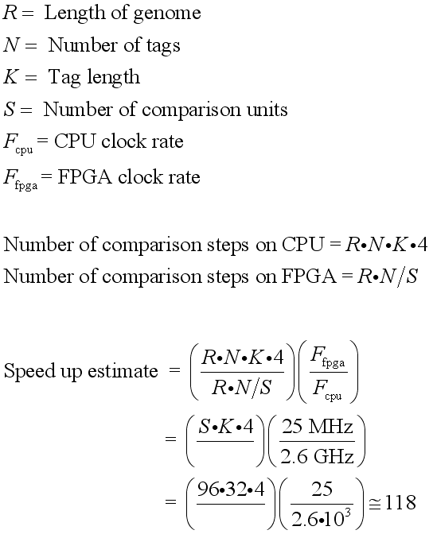
Notes:
Estimate of the speedup achievable from an FPGA design over a CPU design.
We should be able, with 96 comparison units to achieve 118-fold increase in performance assuming no overheads.

Slide 32
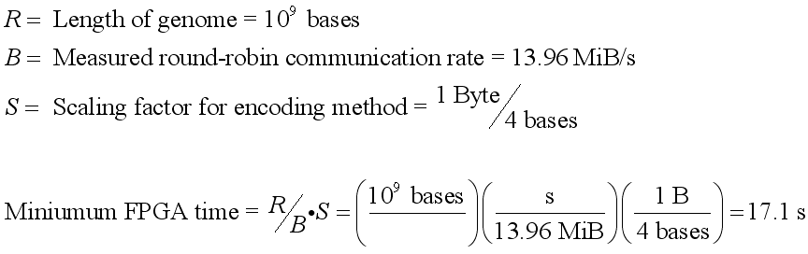
Notes:
After measuring the maximum round-robin throughput of the Ethernet layer, we can estimate the minimum time necessary to run our design, i.e. the time necessary to transfer the data.

Slide 33
Notes:
Measured performance of the FPGA design for various numbers of tags.
While the CPU version degrades in performance as the tag count increases, the FPGA design contains to run at the same speed.
For 96 tags, we measured a speedup of 390-fold.

Slide 34
Notes:
Consider the situation when there are only two tags.
The observed speedup is tenfold on an FPGA design running at a slow 25 MHz over a CPU running at 2.6 GHz.
Does this make sense?

Slide 35
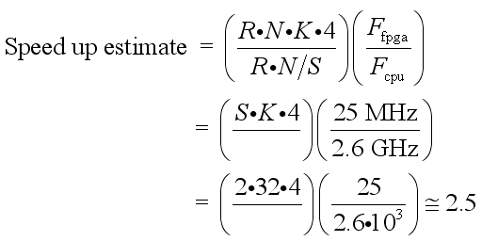
Notes:
Returning to our speed equation, we see indeed the FPGA is predicted to out perform the CPU. While underestimating the actual, this estimate is a crude approximation.
It also does not include all the levels of parallelism present in the FPGA design so should be expected to be an underestimate.

Slide 36
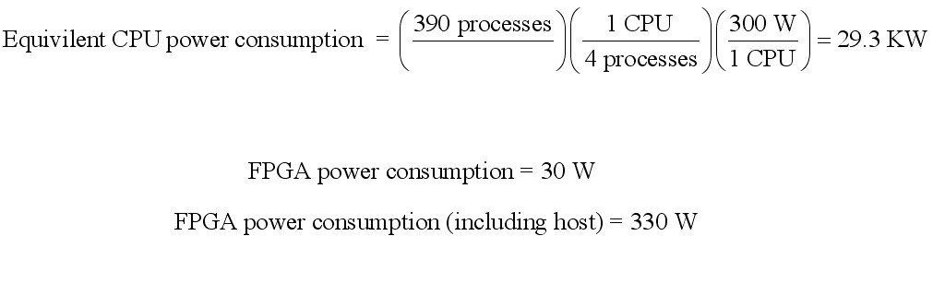
Notes:
Another interesting observation is the power difference between the CPU and FPGA designs at the high end of the speedup graph.
Using quad core computers consuming 300 W as a standard, scaling the CPU design to the equivalent FPGA performance would require 29.3 KW
It needs to be acknowledged that our design does require a host CPU to send and process the results, however, the CPU time required is comparable to that of the FPGA.

Slide 37
Notes:
If we do not improve the design any further or add additional comparison units, we would need to stream the data multiple times.
However, the FPGA’s performance advantage is predicted to be maintained.

Slide 38
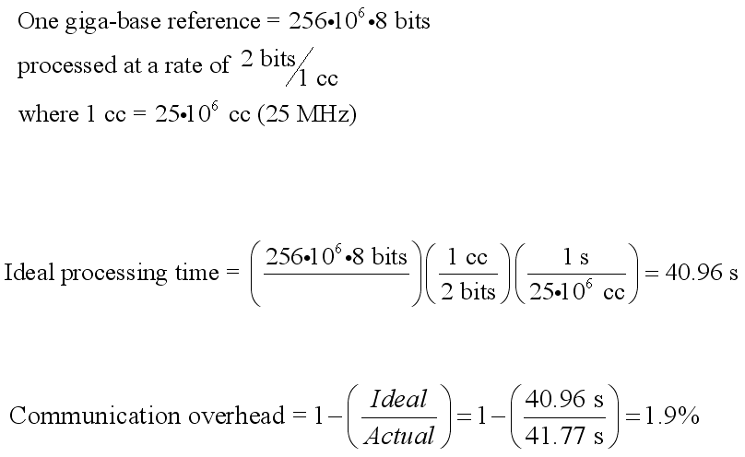
Notes:
The overhead of communication is surprisingly low.
The first time the data is streamed the overhead is closer to 50%, but each consecutive time the overhead is ~2%.
The reason for the initial high overhead is unknown.
It cannot be configuration of the comparison units given this has a very short window in which to complete.
Measured round-robin communication rate of Ethernet interface: 13.96MiB/s

Slide 39
Number of compare units | Occupied slices (of 11,200) | Percentage of chip
2 | 800 | 7.14%
4 | 851 | 7.60%
8 | 1504 | 13.43%
16 | 2595 | 23.17%
32 | 3418 | 30.52%
64 | 5969 | 53.29%
96 | 9623 | 85.92%
Notes:
Designs with 64 and 96 compare units used higher optimization.
With 64 compare units, with default optimization settings place and route ran over a day with no end in sight.
By mistake, SmartXplorer was run on this design, and it found a combinations of optimization parameters (GlobalOpt Design) that required only ~30 and 60 mins for designs with 64 and 96 compare units respectively.
LUT consumption scales nicely with the number of compare units so there is lot of room for improvement simply by purchasing a larger chip.

Slide 40
Notes:
Here we examine three important project design metrics normalized against the smallest value in each metric.
It is clear that FPGAs have advantages for this problem in the domains of performance and power consumption.
However, the extra Engineering Effort is bothersome.
It is true that we are quite comfortable with C development and novices to FPGA design and VHDL.
However, it is hard to imagine anyone implementing this design in the same amount of time required to implement the CPU design.

Slide 41
Next steps
Replace Gb Ethernet interface with PCIe
Extend to 128-mers tags and allow smaller tags via masking
Enable reconfiguration of tags
Store multiple tags in each comparison unit
Manual place and route (optimize) the comparison units
Pipeline design
Introduce timing constraints
Increase clock rate
Notes:
This design fulfills the goal of demonstrating the utility of FPGAs for tag matching.
For actual use, additional improvements are necessary.
Future improvements include the following.

Slide 42
Ancillary slides follow
Notes:
Finally, we must acknowledge Matt Clausman and especially Dr. Jones for the “no time is too late” help with questions.

Slide 43
CPU Method 2
Stage 1:
For every k-mer in genome, store k-mer its position in a sorted structure
Stage 2:
For every tag, query sorted structure and report positions
Stage 3:
For every tag, construct the set H of strings that are 1, 2, … maxHD Hamming distance from the tag
For every tag in H, query sorted structure and report positions
Notes:
This method is faster for some situations as it converts a linear term to a logarithmic term by using a sorted structure. It is especially fast for exact matches of even large sets of tags as further optimizations are possible (i.e. sort the tags).
However, allowing mismatches replaces a previously linear term with a factorial term in stage 3.
For small numbers of mismatches this approach is faster, but quickly becomes slower than the first method. More mismatches have to be allowed as the tag length increases.
This method also has the disadvantage of having to store a large sorted structure for each tag length being examined.

Slide 44
A = 00
C = 01
G = 10
T = 11
GACT = 10000111 (original)
CTGA = 01111000 (reverse)
AGTC = 00101101 (reverse complement)
Notes:
Our encoding scheme reduces the space required for transmission by fourfold.
It also allows us to obtain the complement sequence by simply using bitwise complementation.

